Slide 1




Healthcare Census

Slide 2
Overview:
This project involves processing and cleaning healthcare, census, housing, and government hospital data. Insights are gained from the hospital data to identify states needing more beds urgently. Analysis is conducted to determine if regions meet the WHO standard of 3 beds per 1000 people. The project also calculates the gap in facilities and recommends areas for new hospitals based on shortage.

Slide 3
Tools and Technologies Used:
Jupyter Notebook
VS Code

Slide 4
Libraries/Packages/Features Used:
Pandas: Data manipulation and analysis library for working with structured data.
NumPy: Fundamental package for scientific computing with support for multi-dimensional arrays and mathematical functions.
Matplotlib: Plotting library for creating visualizations in Python.
Seaborn: Statistical data visualization library built on top of Matplotlib.

Slide 5
Headline Statistics (1/2):
Average Execution Time: 5 Days
Wakatime Metrics:
Total Coding Time: 18 hrs
Daily Coding Activity: 4 hrs
Most Active Time: 11 pm to 2 am
Top Files and Languages: health.py(Python)
Lines of Code (LoC/KLoC): The total number of lines of code or thousands of lines of code in the project, serving as a measure of project complexity and size.
Total Number of Functions: 3 (rename_state,find_missing_values_indices,clean_state_name)
Number of User-defined Functions Used: 3
Avg. Number of Lines per Function: 8 lines

Slide 6
Headline Statistics (2/2):
Number of comments written: 2 – 3 comments for every code snippet
IDE/Code Editor Used: Jupyter Notebook
Plugins Used: None
Function/Complexity breakdown:
Simple Implementations: Basic tasks like renaming and counting
Intermediate Implementations: Handling null values
Complex Implementations: Visualize data properly using appropriate logic

Slide 7
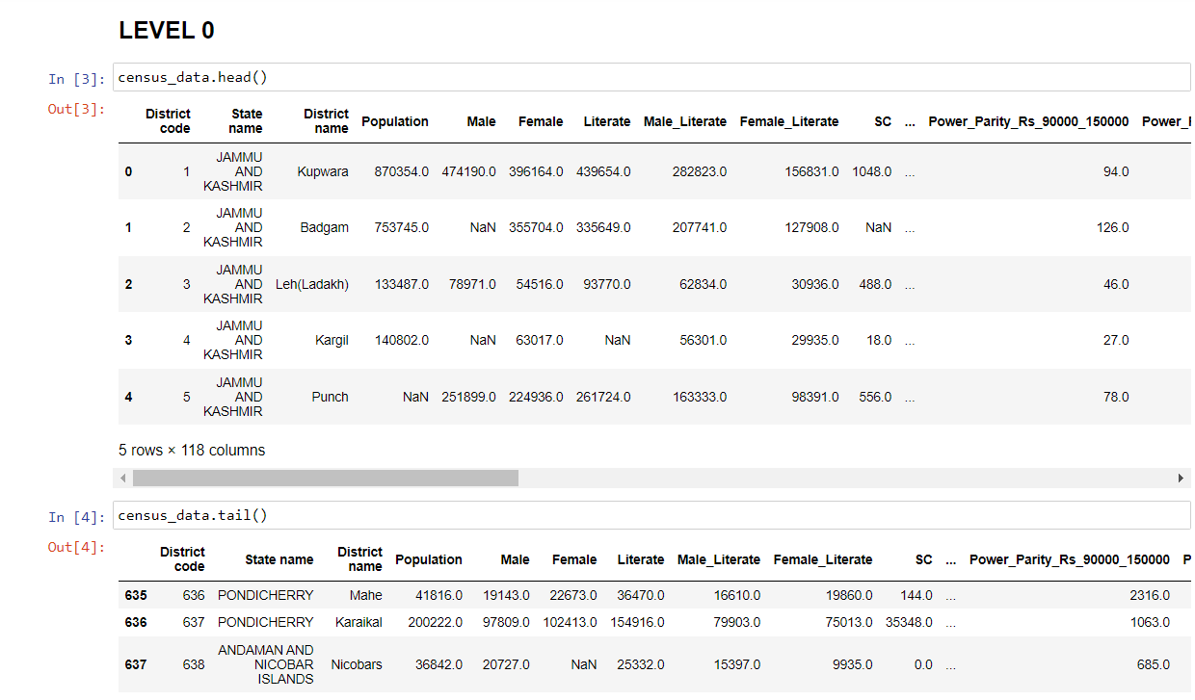
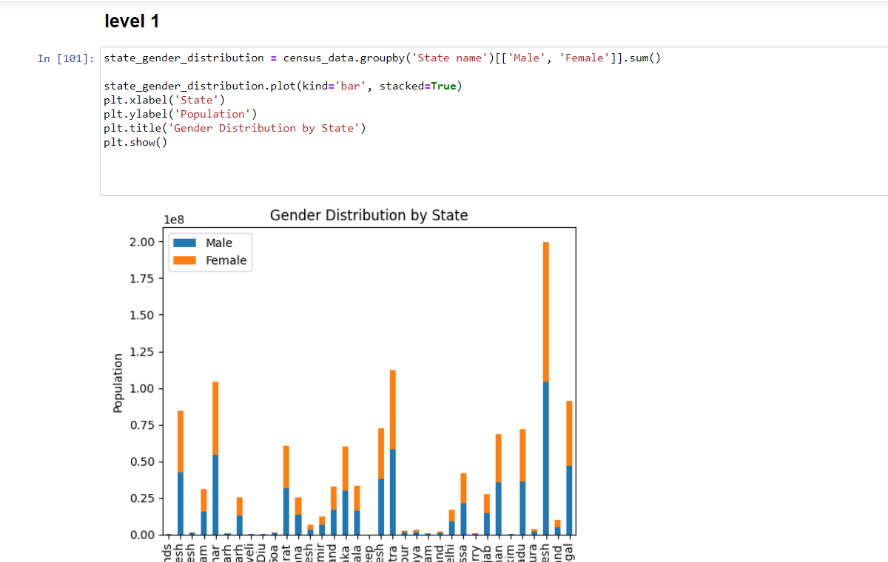
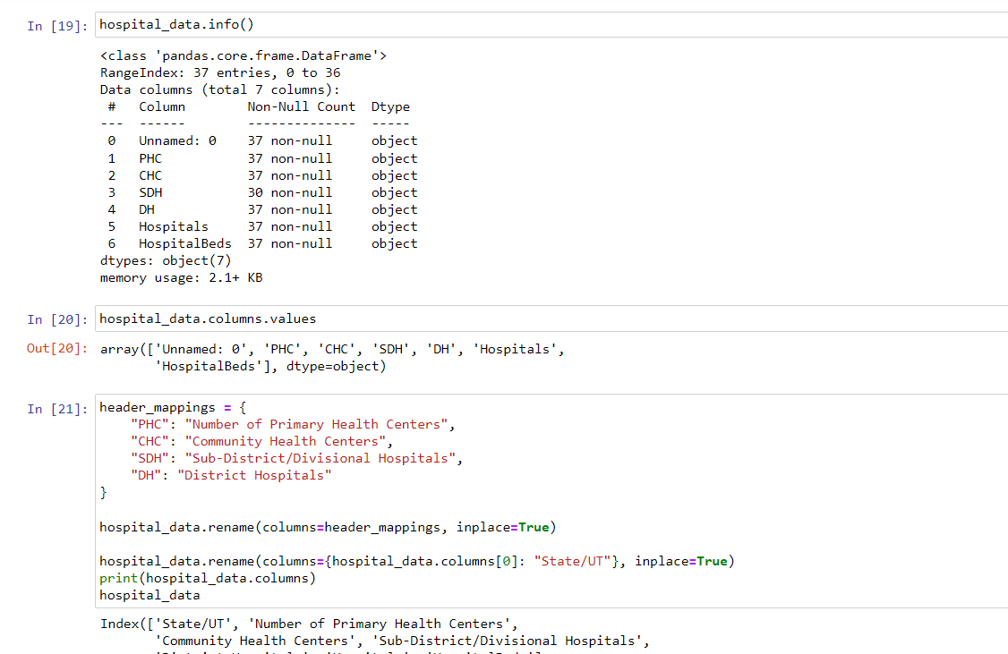
Implementation Screenshots/Code Snippets:

Slide 8
Highlights & Standout Features:
Robust data cleaning and preprocessing techniques applied.
Effective missing data imputation methods implemented.
Seamless integration with updated regions.
Valuable insights and analysis derived from the census data.
Clear and compelling data visualizations and reporting.
Optimized performance through efficient data processing.
Well-documented code and project organization for easy maintenance.
Compliance with WHO standards for healthcare facilities.
Recommendations for addressing healthcare facility gaps.

Slide 9
Optimizations and Best Practices Used:
Efficient data processing and parallel computing techniques utilized for faster and optimized data analysis.
Memory optimization and utilization of memory-efficient data structures for improved performance.
Code optimization, including vectorized operations and avoiding unnecessary loops, for enhanced execution speed.
Indexing and caching mechanisms employed to improve query performance and reduce redundant computations.
Profiling and optimization of critical code sections to identify and address performance bottlenecks.
Regular updates and adherence to best practices to leverage new features and ensure optimal performance.
Well-documented code with clear comments and organization for enhanced readability and maintainability.

Slide 10
Roadblocks & Resolutions
Roadblocks:
Inconsistent and messy data: Dealing with data that is inconsistent, contains errors, or lacks uniformity in nomenclature can make it challenging to process and analyze the census data effectively.
Missing data: Some fields in the census data may have missing values, which can impact the accuracy and completeness of the analysis.
Formation of new states and Union Territories: Changes in the political landscape may require aligning the census data with the new states and Union Territories formed since the data was captured.
Resolutions:
Data cleaning and preprocessing: Implementing data cleaning techniques such as removing duplicates, handling missing values, standardizing nomenclature, and resolving inconsistencies to ensure the data is accurate and usable.
Data imputation: When encountering missing data, using techniques like interpolation, mean substitution, or predictive modeling to fill in the missing values based on other available data.
Update data with new regions: Updating the census data by incorporating information about new states and Union Territories to ensure compatibility with later captured data.
Collaboration with stakeholders: Engaging with relevant departments or experts to clarify any data discrepancies or address challenges related to the data and its interpretation.

Slide 11
Future Scope:
Exploring advanced statistical and machine learning techniques for deeper insights.
Integrating real-time data sources for more accurate and timely analytics.
Utilizing geographic visualization to understand regional healthcare needs.
Collaborating with other data sources for comprehensive analysis.
Longitudinal analysis for tracking healthcare trends over time.
Incorporating patient-level data for personalized healthcare analysis.
Optimizing resource allocation using optimization algorithms.
Develop interactive dashboards for collaborative decision-making.
Establishing benchmarks for performance evaluation and improvement.

Slide 12
Thank You

